Slide 1
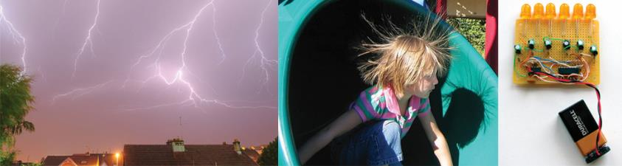
Electrochemistry

Slide 2
Electromotive Force
Voltaic Cell: Chemical energy transformed into electrical energy by spontaneous redox reaction (battery); also called galvanic cell
Electromotive Force (emf): The force pushing electrons through an electrical circuit; also called voltage
Cell Potential (E_{cell}): The emf of an electrochemical cell

Slide 3
Video of following slides:
Standard Cell potential
Here to Voltage and Work

Slide 4
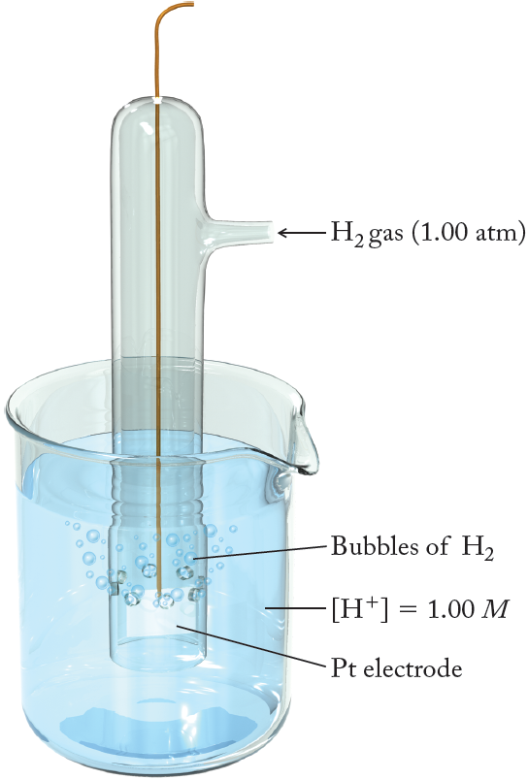
Standard Hydrogen Electrode (SHE)
2H⁺(aq) + 2e– → H₂(g)
E°_{SHE} = 0.00 V
At all temperatures
(can serve as anode or cathode)
Pt ⏐H₂(1.0 atm)⏐H⁺(1.0 M) ||
|| H⁺(1.0 M)⏐H₂(1.0 atm)⏐Pt
As anode:
As cathode:

Slide 5
Standard Potentials
Standard Reduction Potential (Eº): The potential of a half–reaction in which all reactants and products are their standard states generally at 25 °C
Standard Cell Potential (Eº_{cell}): A measure of how forcefully an electrochemical cell (in standard state) can pump electrons through an external circuit
Eº_{cell} = Eº_{cathode} – Eº_{anode}
Remember standard states: concentrations = 1 M,
partial pressure of gases = 1 bar (~1 atm)
Note: some books (lab manual) use a slightly different form of this equation with addition instead of subtraction.

Slide 6
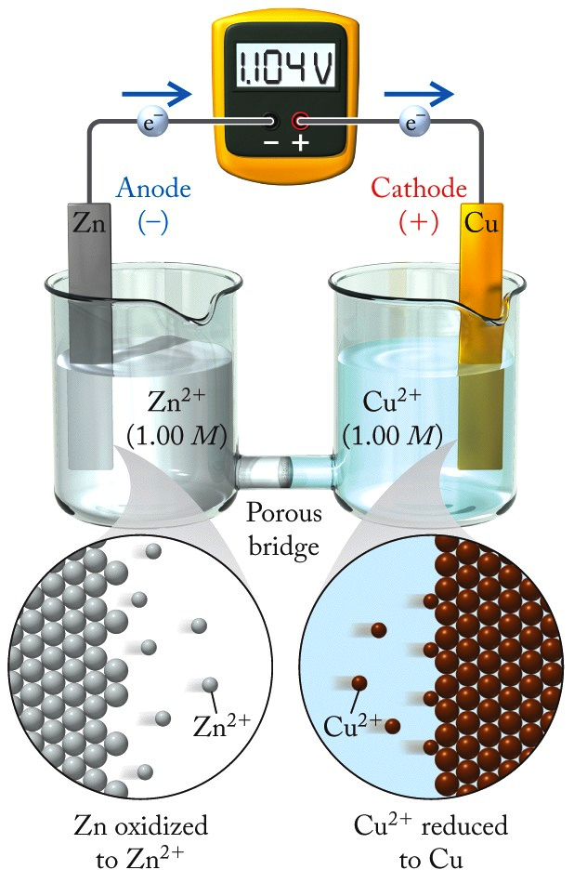
Standard Cell Potential (E°_{cell})
Eº_{cell} = Eº_{cathode} – Eº_{anode}
Standard reduction half–reactions:
cathode
Cu²⁺(aq) + 2e– → Cu(s)
E° = 0.342 V
anode
Zn²⁺(aq) + 2e– → Zn(s)
E° = –0.762 V
(occurring as the reverse reaction, oxidation)
Eº_{cell} = (0.342 V) – (–0.762 V)
= 1.104 V
Question: How do we know what is being oxidized/reduced if a cell diagram or equation is not provided?
The half–reaction with the more positive value of Eº runs as a reduction and the other runs in reverse as an oxidation.

Slide 7
Practice: Standard Cell Potential
Using a table of standard potentials, calculate the standard cell potential for the reaction:
2Fe³⁺(aq) + 2I–(aq) → 2Fe²⁺(aq) + I₂(s)
reduction half–reaction
2Fe³⁺(aq) + 2e– → 2Fe²⁺(aq)
cathode
oxidation half–reaction
2I–(aq) → I₂(s) + 2e–
anode
Note: Eº is an intensive property and does not change with quantities of reactants/products.
Standard Reduction Potentials (from Table A6.1)
Fe³⁺(aq) + e– → Fe²⁺(aq)
Eº = 0.770 V
Eº_{cell} = Eº_{cathode} – Eº_{anode}
Eº_{cell} = 0.770 V – 0.5355 V
I₂(s) + 2e– → 2I–(aq)
Eº = 0.5355 V
Eº_{cell} = 0.235 V

Slide 8

Based on the information in the table of standard reduction potentials below, calculate Eº_{cell} for: Al(s) | Al³⁺(aq) || Br₂(aq), Br–(aq). Half–reaction Eº Pb⁴⁺ + 2e– → Pb²⁺ +1.80 Au³⁺ + 3e– → Au +1.50 Br₂ + 2e– → 2Br– +1.066 Fe³⁺ + 3e– → Fe +0.771 I₂ + 2e– → 2I– +0.535 Pb²⁺ + 2e– → Pb –0.124 Al³⁺ + 3e– → Al –1.66 Mg²⁺ + 2e– → Mg –2.37 K⁺ + e– → K –2.93
Your Turn TopHat: Electrochemical Potential
+0.12 V
+2.73 V
–2.73 V
–0.59 V
+0.59 V

Slide 9
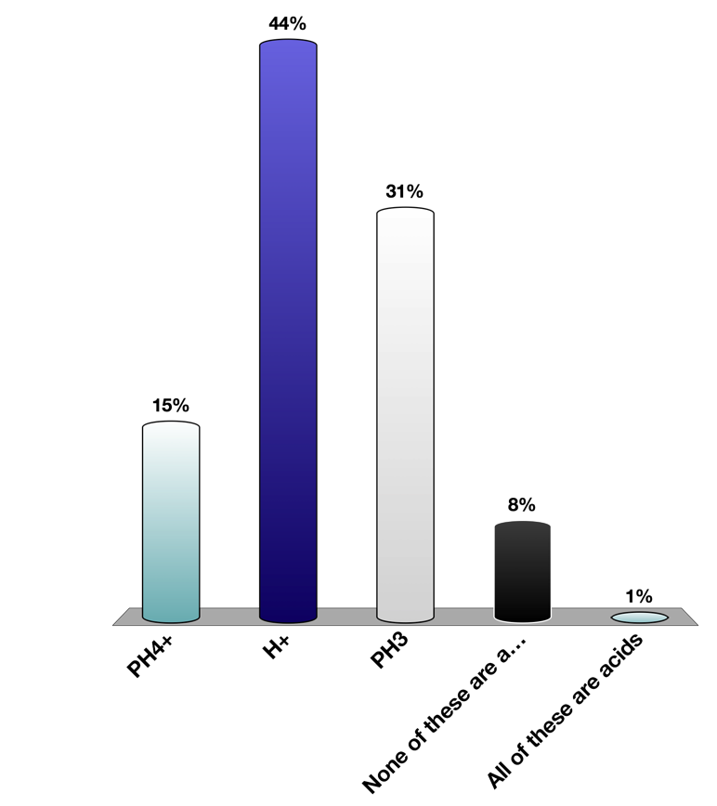
Based on the information in the table of standard reduction potentials below, calculate Eº_{cell} for: Al(s) | Al³⁺(aq) || Br₂(aq), Br–(aq). Half–reaction Eº Pb⁴⁺ + 2e– → Pb²⁺ +1.80 Au³⁺ + 3e– → Au +1.50 Br₂ + 2e– → 2Br– +1.066 Fe³⁺ + 3e– → Fe +0.771 I₂ + 2e– → 2I– +0.535 Pb²⁺ + 2e– → Pb –0.124 Al³⁺ + 3e– → Al –1.66 Mg²⁺ + 2e– → Mg –2.37 K⁺ + e– → K –2.93
Your Turn TopHat: Electrochemical Potential
anode (oxidation half–reaction)
Al(s) → Al³⁺(aq) + 3e–
cathode (reduction half–reaction)
Br₂(aq) + 2e– → 2Br–(aq)
Eº_{cell} = Eº_{cathode} – Eº_{anode}
Eº_{cell} = 1.066 V – (–1.66 V)
Eº_{cell} = +2.73 V

Slide 10
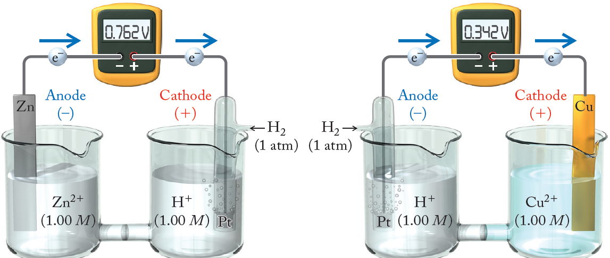
Determination of Eº
← H₂→
(1 atm)
0.762 V = E_{SHE} – E_{Zn}
0.762 V = 0.00 V – E_{Zn}
0.342 V = E_{Cu} – E_{SHE}
0.342 V = E_{Cu} – 0.00 V
Allows us to determine potentials for individual half–reactions, if the cell potential can be measured.

Slide 11
Video of following slides:
Voltage and Electrical Work
Here to Nernst Equation

Slide 12
Voltage and Electrical Work
Consider an electrochemical cell as a thermodynamic “system”:
To be generating an electron current, the system must have a ∆G_{cell} < 0
(in other words, the process is “spontaneous”)
What does ∆G represent?
“the maximum energy released by a system that is available to do useful work”
w_{elec} = work done by the cell, in joules (J)
A positive E_{cell} yields work done by the system, results in a ∆G < 0
Q = charge being moved, in coulombs (C)
E_{cell} = electromotive force (cell potential), in volts (V)
Note: work done by the cell is a negative quantity according to our system–surroundings sign conventions.

Slide 13
Voltage and Electrical Work
If we combine these two equations:
How can we represent Q with quantities that we readily know?
Here Q is NOT Q related to K
Q is the charge being moved in coulombs

Slide 14
Voltage and Electrical Work
If we combine these two equations:
How can we represent Q with quantities that we readily know?
Gives coulombs per mol of electrons
Can determine moles (n) of electrons–transferred from overall redox equation!
Gives total charge in coulombs
If we substitute this expression in for Q:
A relationship that relates energetics to electrochemical potentials.

Slide 15
Practice: ∆G and E_{cell}
Calculate the value of ΔG and the work done on the circuit for the reaction,
Mg(s) + Cu²⁺(aq) → Mg²⁺(aq) + Cu(s)
taking place in a voltaic cell that produces 2.71 V.
oxidation half–reaction
Mg(s) → Mg²⁺(s) + 2e–
reduction half–reaction
Cu²⁺(aq) + 2e– → Cu(s)
number of mol electrons involved
n = 2
Relationship of ∆G to E_{cell}

Slide 16
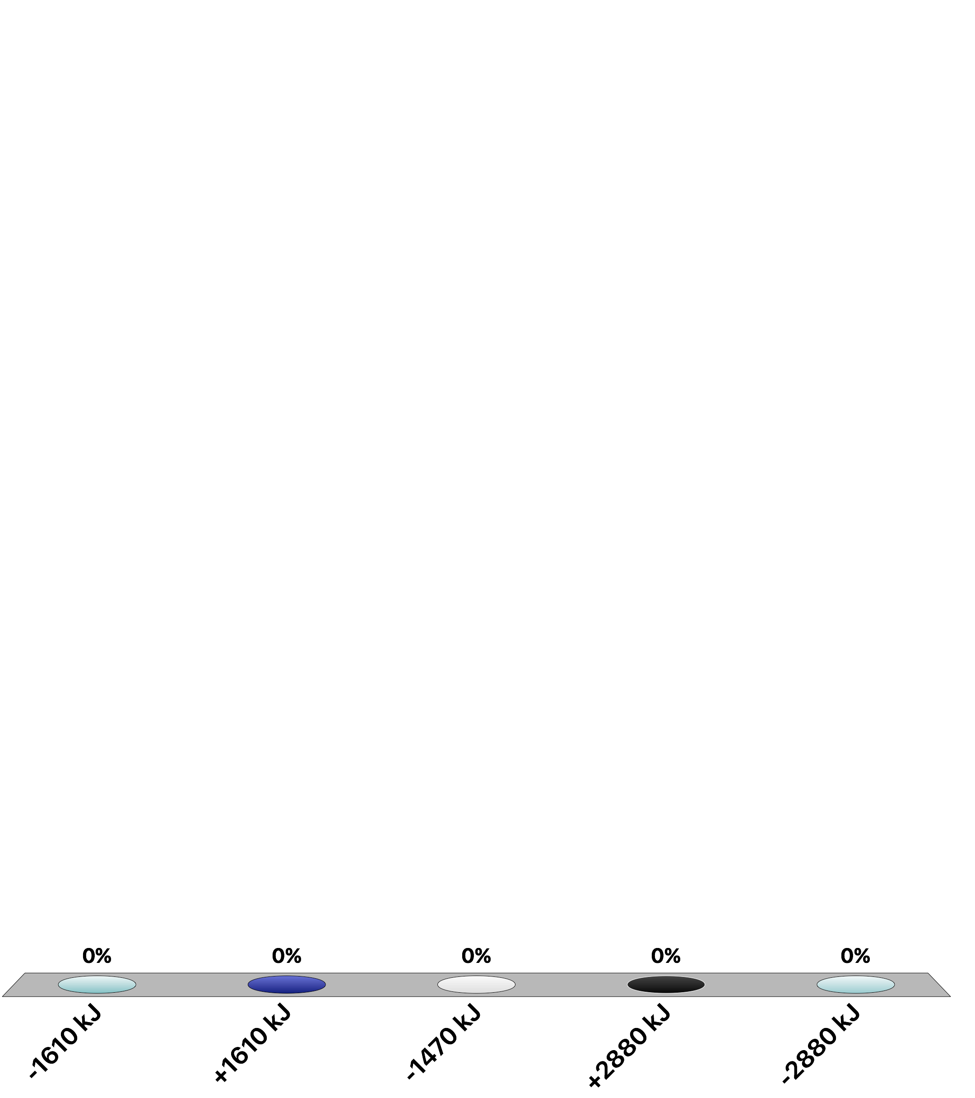
Calculate ∆Gº for an electrochemical cell reaction that occurs under acidic aqueous conditions based on the following two half–reactions for which the standard reduction potentials are given. Use the smallest whole–number coefficients possible when balancing the overall reaction. Cr₂O₇^{2–} + 14H⁺ + 6e– → 2 Cr³⁺ + 7H₂O +1.33 V CH₃COOH + 4H⁺ + 4e– → C₂H₅OH + H₂O +0.058 V
Your Turn TopHat: Electrochemical Potential
–1610 kJ
+160 kJ
–1470 kJ
+2880 kJ
–2880 kJ

Slide 17
Calculate ∆Gº for an electrochemical cell reaction that occurs under acidic aqueous conditions based on the following two half–reactions for which the standard reduction potentials are given. Use the smallest whole–number coefficients possible when balancing the overall reaction. Cr₂O₇^{2–} + 14H⁺ + 6e– → 2Cr³⁺ + 7H₂O +1.33 V CH₃COOH + 4H⁺ + 4e– → C₂H₅OH + H₂O +0.058 V
Your Turn TopHat: Electrochemical Potential
largest, so reduction
First, recognize which half–reaction is going to be reduction/oxidation based on standard potentials.
3
C₂H₅OH + H₂O → CH₃COOH + 4H⁺ + 4e–
oxidation half–reaction
reduction half–reaction
2
Cr₂O₇^{2–} + 14H⁺ + 6e– → 2Cr³⁺ + 7H₂O
Need E_{cell}:
Can calculate ∆G_{cell}:
n = 12 mol e–

Slide 18
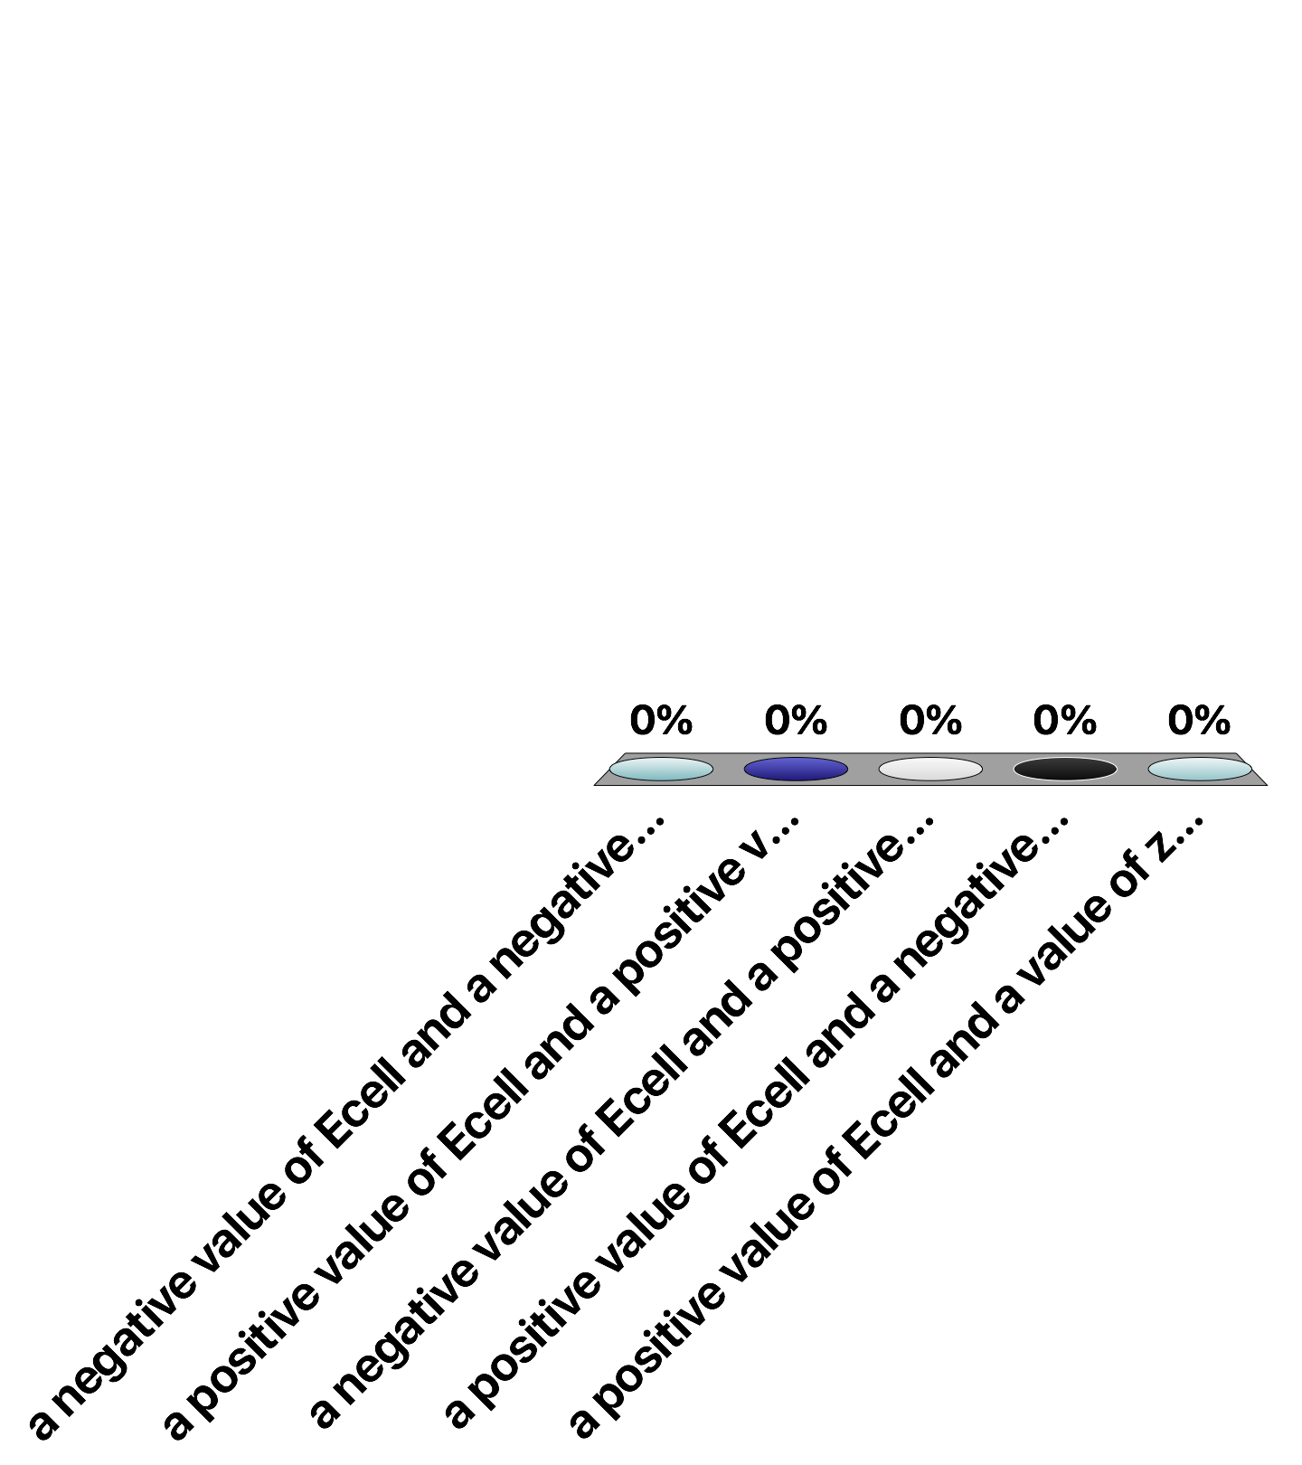
The spontaneous redox reaction in a voltaic cell has______
TopHat: Electrochemical Potential
a negative value of E_{cell} and a negative value of ∆G.
a positive value of E_{cell} and a positive value of ∆G.
a negative value of E_{cell} and a positive value of ∆G.
a positive value of E_{cell} and a negative value of ∆G.
a positive value of E_{cell} and a value of zero for ∆G.

Slide 19
Video of following slides:
Nernst Equation
Here to Electrolytic cells (non-spontanesous)

Slide 20
Nernst Equation
How does one calculate cell potentials under non–standard conditions?
Everything to this point has been done at “standard” conditions:
Aqueous concentrations: 1 M; partial pressure of gases: 1 bar; temperature: 298 K
Electrochemical cells (batteries, etc.) are rarely constructed using these restrictive parameters. How can thermodynamic quantities be related at non–standard conditions?
Where,
Q = reaction quotient
R = 8.314 J/mol·K
From Chapter 14, for some rxn:
Rewrite using “cell” instead of “rxn”
Notice: don’t confuse reaction quotient, Q, with charge, Q

Slide 21
Nernst Equation
Where,
Q = reaction quotient
R = 8.314 J/mol·K
From Chapter 14, for some rxn:
Rewrite using “cell” instead of “rxn”
Substitute expressions for ∆G:
Divide both sides by –nF:
Notice: change from ln to log
Very commonly this expression is simplified:
Nernst Equation
for electrochemical cells at 298 K
gives relationship between cell potential at standard and non–standard conditions

Slide 22
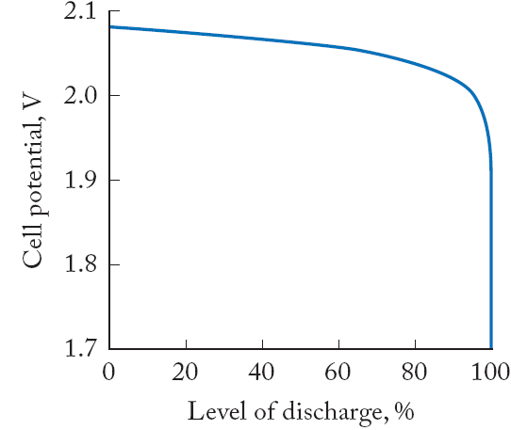
Battery Discharge & Nernst Equation
Log relationship between E_{cell} and Q translates into gradual decrease in cell potential until almost complete discharge

Slide 23
Eº_{cell} and K
At equilibrium,
∆G = 0 so, E_{cell} = 0 and Q = K
Rearranging the Nernst equation:
again, this form, only applicable at 298 K
Can calculate the equilibrium constant, knowing the standard reduction potential of a electrochemical cell.

Slide 24
Practice: Cell Potential and K
Calculate K from the standard cell potential for the reaction below at 25ºC.
Fe(s) + Pb²⁺(aq) → Pb(s) + Fe²⁺(aq)
reduction (cathode)
Pb²⁺(aq) + 2e– → Pb(s)
n = 2 e–
oxidation (anode)
Fe(s) → Fe²⁺(aq) + 2e–
Standard Reduction Potentials (from Table A6.1)
Nernst Equation (for K)
Fe²⁺(aq) + 2e– → Fe(s)
Eº = –0.447 V
Pb²⁺(aq) + 2e– → Pb(s)
Eº = –0.126 V

Slide 25
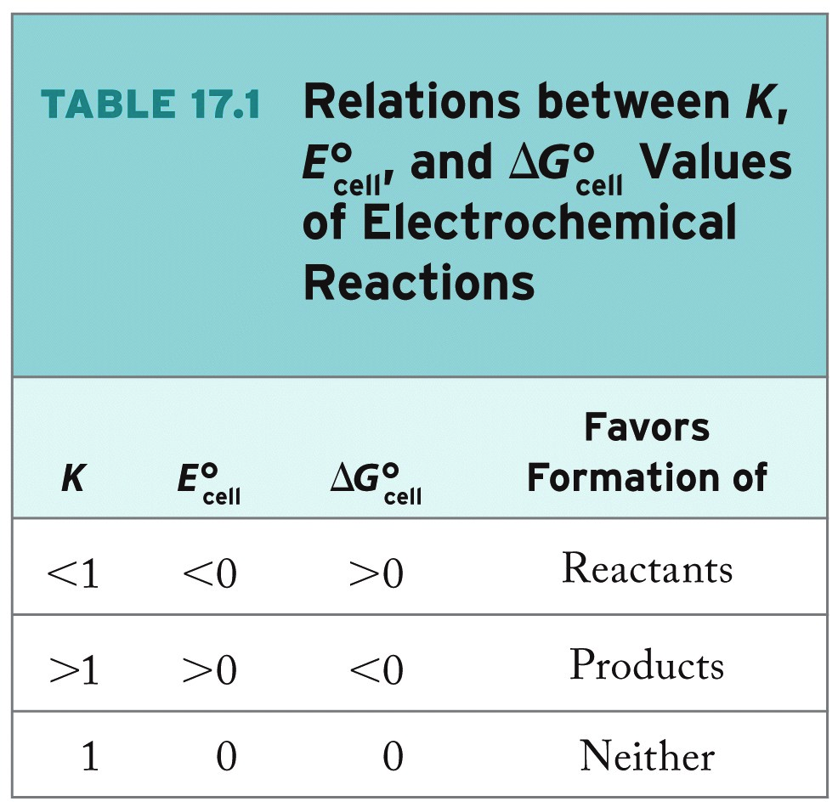
K, Eº_{cell}, and ∆Gº
For most electrochemical cells, K >> 1.
So, the net redox reaction proceeds toward “products”
Since these redox reactions technically have an equilibrium between products & reactants, what happens to our electrochemical cell if we drive the equilibrium backwards towards reactants?

Slide 26
Video of following slides:
Electolytic Cells and Electrical Units
Here to End of Electrochemistry.

Slide 27
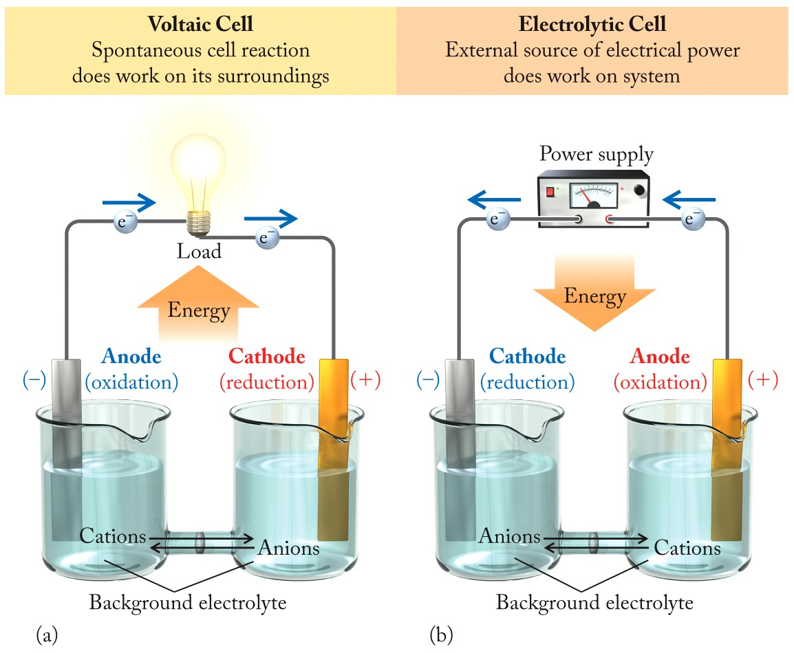
Electrolytic Cells
Q < K
Q > K
chemical energy to electrical energy
electrical energy to chemical energy
Notice: since we are driving the redox reaction in the opposite direction the electrodes have switched half–reactions

Slide 28
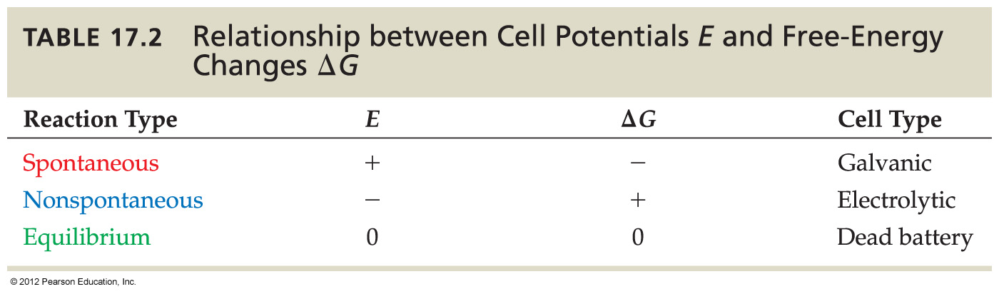
Electrolysis and Electrolytic Cells
(voltaic)

Slide 29
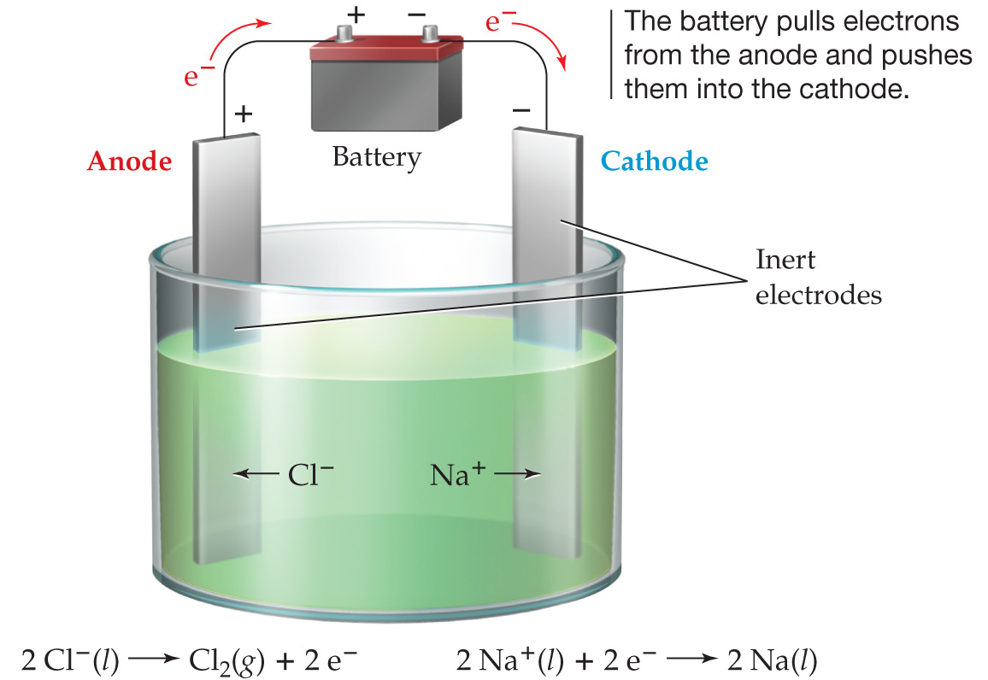
Electrolysis and Electroplating
Electrolysis:
Providing energy to electrochemical cell to drive a nonspontaneous redox reaction
Example: 2Na⁺(ℓ) + 2Cl–(ℓ) → 2Na(ℓ) + Cl₂(g)
Electrolysis of molten sodium chloride

Slide 30
Electrical Energy: Units
Current:
charge per unit time
units: amperes (A) = coulombs/second (C/s)
Work:
charge moved across electric potential difference
units: joules (J) = coulomb·volt (C·V)
= (ampere·second)(volt) (A·s·V)
Power:
energy capacity; work per unit time
units: watt (W) = joule/second (J/s)
1 C = 1 A∙s

Slide 31
Practice: Electrolytic Plating
How much time is required to deposit 0.100 g of silver onto a bracelet from a solution containing Ag⁺ ions using a current of 250 mA (1 A = 1 C/s)?
half–cell equation
Ag⁺(aq) + e– → Ag(s)
Faraday’s constant
(this gets you out of electrical units and into reaction stoichiometry)

Slide 32
An electrochemical cell has both a silver anode and a silver cathode. The solutions of silver nitrate in contact with the electrodes have different concentrations. Which statement(s) correctly describe this cell? I. The cell potential is 0. II. The cell potential is negative. III. The cell potential is positive. IV. No electrons will flow through the external circuit.
Your turn TopHat: Electrochemical Potential
I only
II only
III only
I and IV
II and IV
Notes:
Only difference is which way you hook up the voltmeter positive in one direction.

Slide 33
An electrochemical cell has both a silver anode and a silver cathode. The solutions of silver nitrate in contact with the electrodes have different concentrations. Which statement(s) correctly describe this cell? I. The cell potential is 0. II. The cell potential is negative. III. The cell potential is positive. IV. No electrons will flow through the external circuit.
Your turn TopHat: Electrochemical Potential
I only
II only
III only
I and IV
II and IV
Notes:
Only difference is which way you hook up the voltmeter positive in one direction.

Slide 34
Neuron cells generate electrical signals by concentration gradients across membranes. Assuming a potassium ion concentration of 0.00300 M inside the cell, and a concentration of 0.135 M outside the cell, what is the electrical potential across the cell membrane? Body temperature is 310 K. (Note: the sign identifies the change in the electrical potential across the membrane and which way the ions flow.)
Your Turn TopHat: Nernst Equation
+102 mV
–136 mV
+10.0 mV
–204 mV
+204 mV

Slide 35
Neuron cells generate electrical signals by concentration gradients across membranes. Assuming a potassium ion concentration of 0.00300 M inside the cell, and a concentration of 0.135 M outside the cell, what is the electrical potential across the cell membrane? Body temperature is 310 K. (Note: the sign identifies the change in the electrical potential across the membrane and which way the ions flow.)
Your Turn TopHat Solution: Nernst Equation
Nernst Equation
Need to use this form as we aren’t at 298 K
In this case, not different half–reactions, but just a difference in concentration:
Osmosis occurs from high concentration to low concentration, so:

Slide 36
Practice: Nernst Equation
Consider the cell reaction below, starting at standard conditions:
Cu²⁺(aq) + Zn(s) → Zn²⁺(aq) + Cu(s)
Determine the cell potential after the reaction has proceeded enough for the [Zn²⁺] to have changed by 0.35 mol/L at 25 ºC.
n = 2 e–
Nernst Equation
Standard Reduction Potentials (from Table A6.1)
Cu²⁺(aq) + 2e– → Cu(s)
Eº = 0.342 V
Zn²⁺(aq) + 2e– → Zn(s)
Eº = –0.762 V

Slide 37
If 15 g of aluminum from an empty soda can could be used as an anode of a battery, how long could it supply a current of 10 A? (A = C/s,)
Your Turn TopHat: Electrochemical Cells
45 hr
15 hr
5.4 hr
4.5 hr
1.5 hr

Slide 38
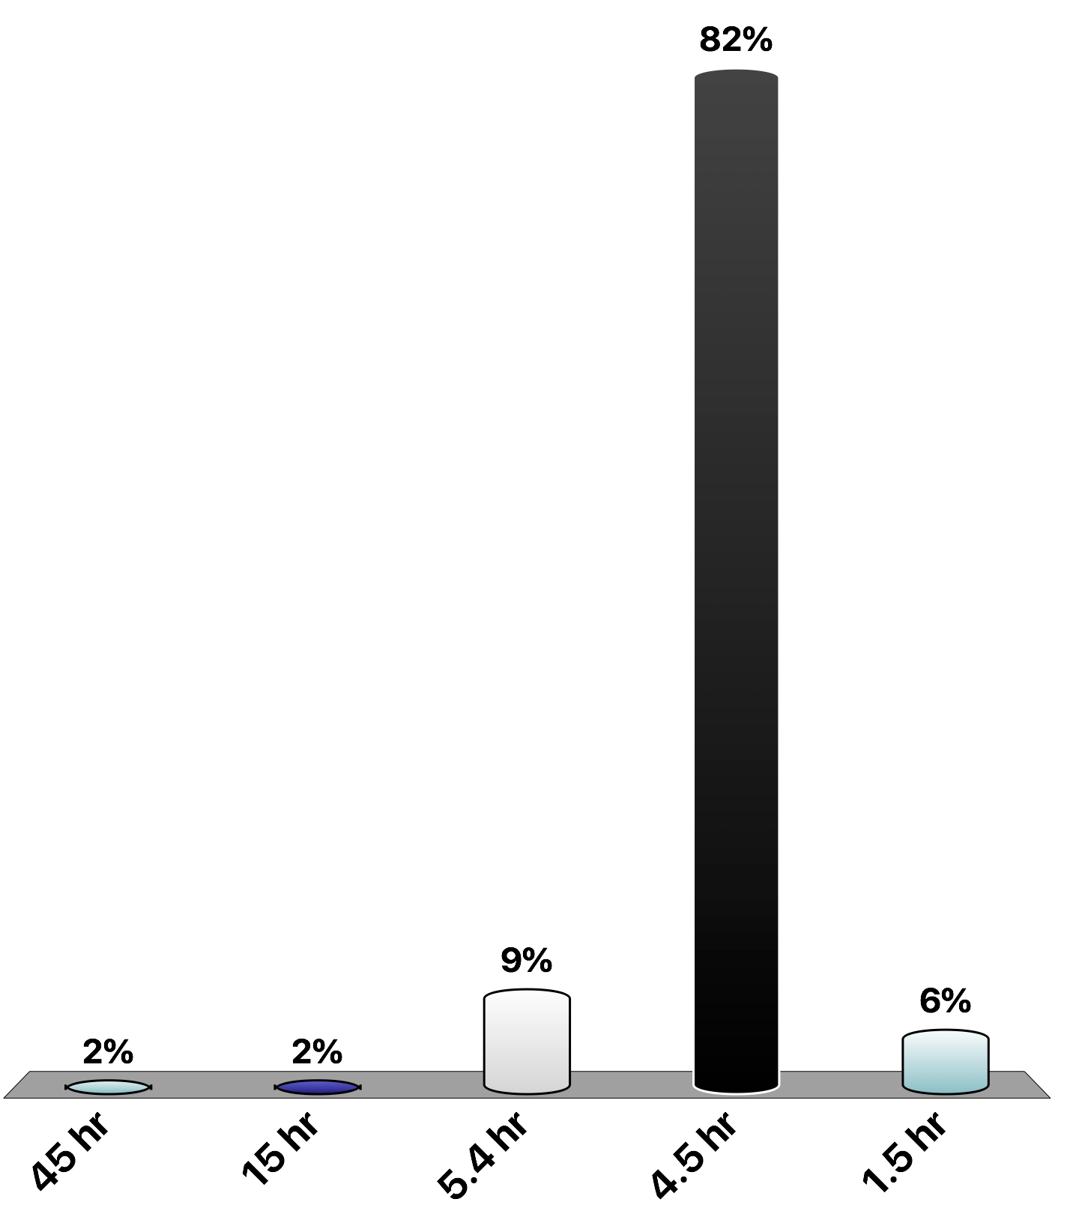
If 15 g of aluminum from an empty soda can could be used as an anode of a battery, how long could it supply a current of 10 A? (A = C/s,)
Your Turn TopHat: Electrochemical Cells
half–cell equation
Al³⁺(aq) + 3e– → Al(s)
45 hr
15 hr
5.4 hr
4.5 hr
1.5 hr

Slide 39
17.74. What amount of current is required to deposit 0.750 g of Pt(s) from a solution containing the [PtCl₄]^{2–} ion within a time of 2.5 hours?
Practice: Electrical Energy Units
[PtCl₄]^{2–} + 2e– → Pt(s) + 4Cl–

Slide 40
Practice: Electrolytic Cells
A battery charger used to recharge the NiMH batteries used in a digital camera can deliver as much as 0.35 A of current. If it takes 145 minutes to recharge one battery, how many g Ni(OH)₂ are oxidized to NiO(OH)?
H₂O(ℓ) + e– + NiO(OH)(s) → OH–(aq) + Ni(OH)₂(s)

